Slide 1
Robot motions-ii
PDE4431 Industrial Manipulators
Judhi Prasetyo & Bittu Scaria
Middlesex University Dubai

Slide 2
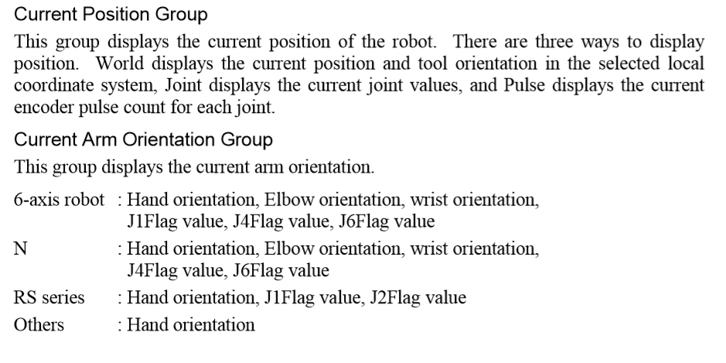
Current Position and Orientation

Slide 3
Robot Arm Orientations
When developing a robot program, it is necessary to specify the point data taught for a particular arm orientation. If you fail to do so, the position can deviate slightly depending on the arm orientation, which in turn can cause the arm to follow an unexpected path, resulting in interference with peripheral equipment. This can be dangerous! To prevent this from happening, the orientation that the arm will be in when moved to the given point should be specified ahead of time in the point data. Such information can also be changed from the program.

Slide 4
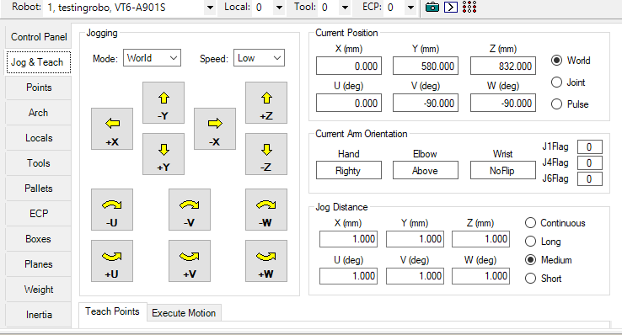

Slide 5
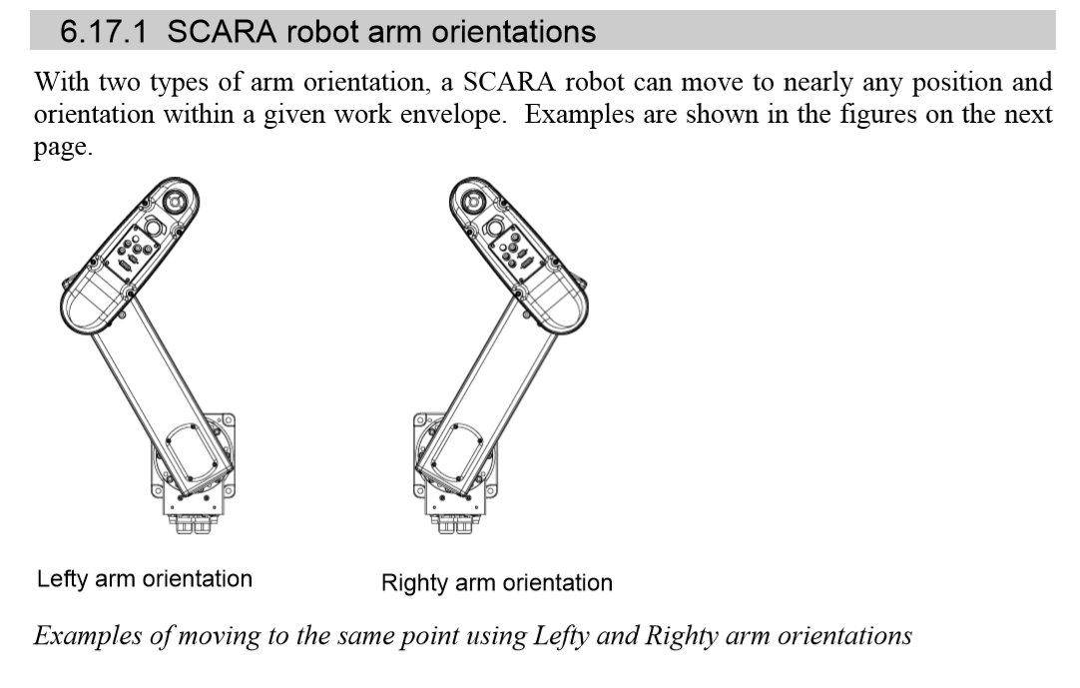

Slide 6
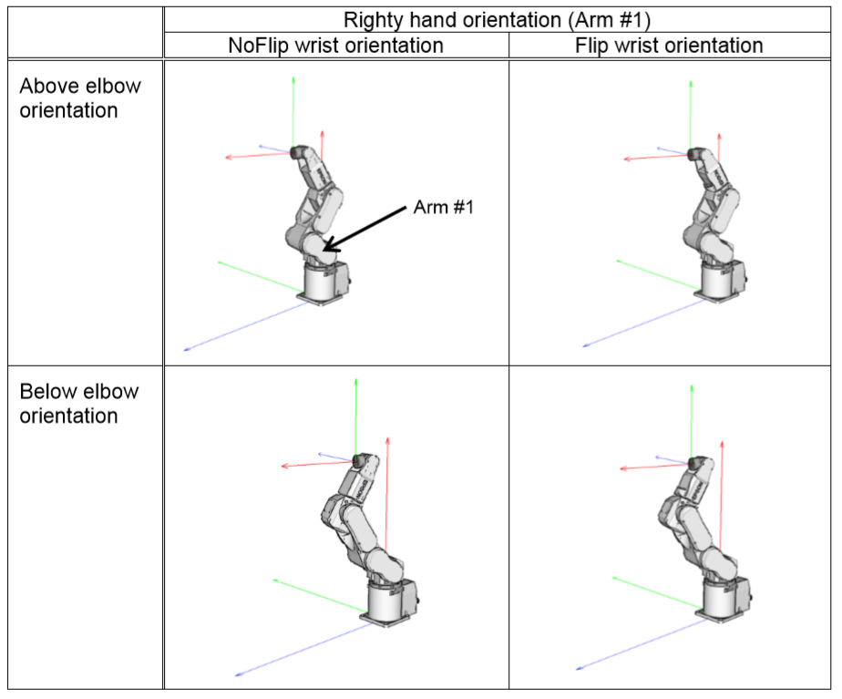
6-axis robot arm orientation

Slide 7
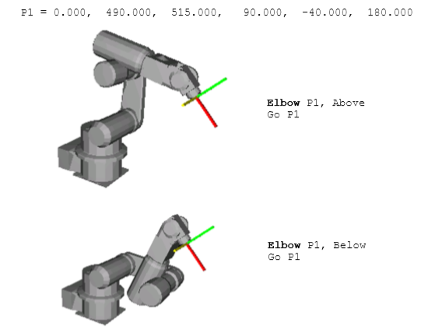
Example of orientation difference-Elbow

Slide 8
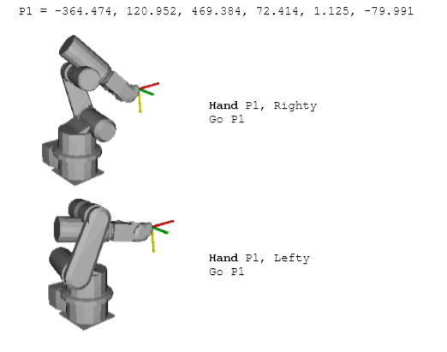
Example of orientation difference-Hand

Slide 9
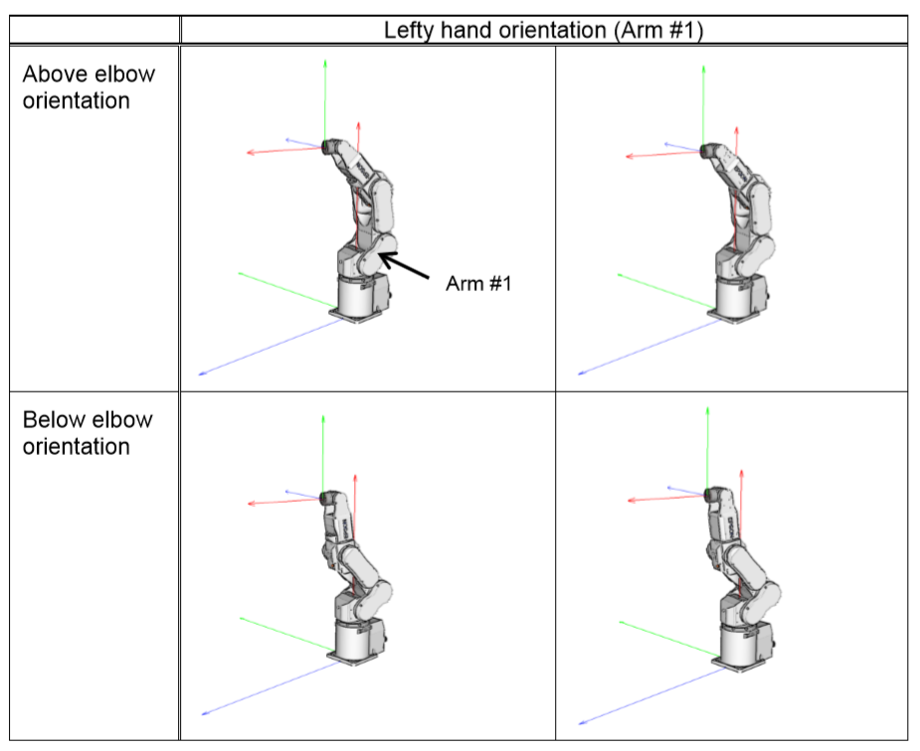

Slide 10
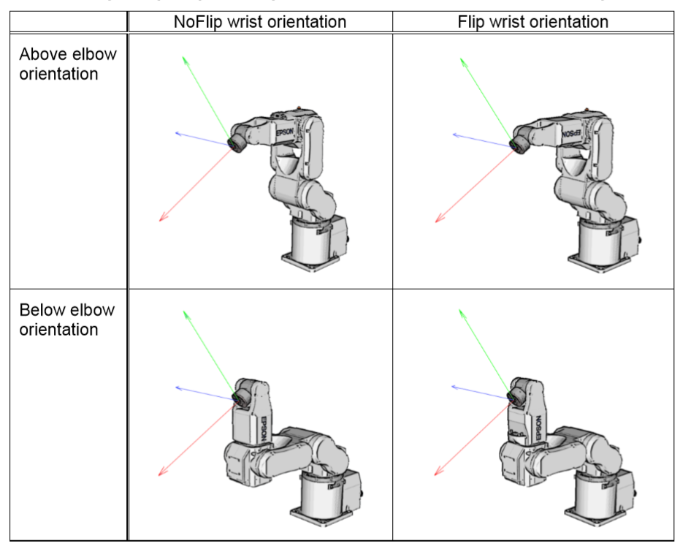

Slide 11
Exercise 1
Jog robot to and record points on following configuration as per the exercise chart provided.

Slide 12
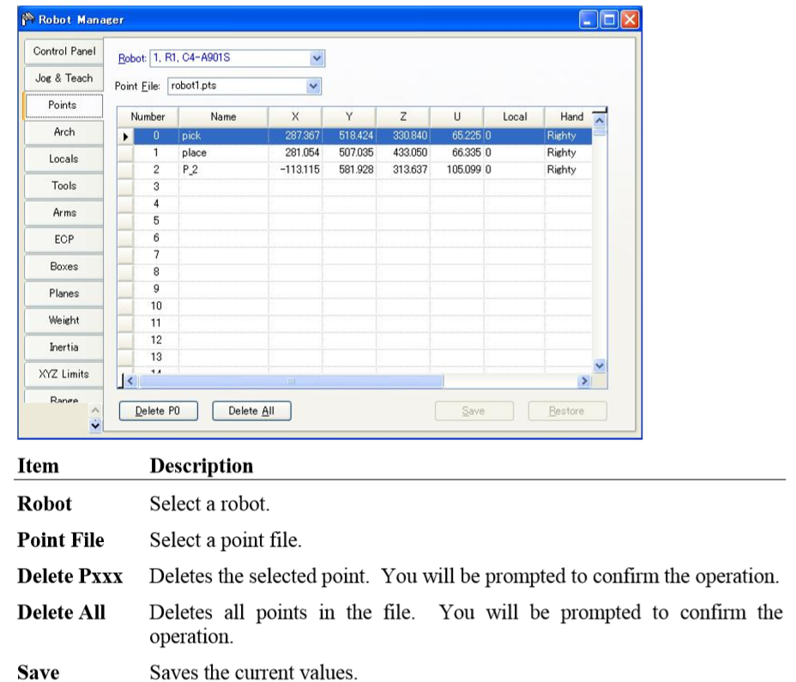
You can input/delete the point data. When a point file is selected, the robot controller loads the file into memory. As points are taught on the [Robot Manager]-[Jog & Teach] page, the spreadsheet on the Points page is updated.

Slide 13
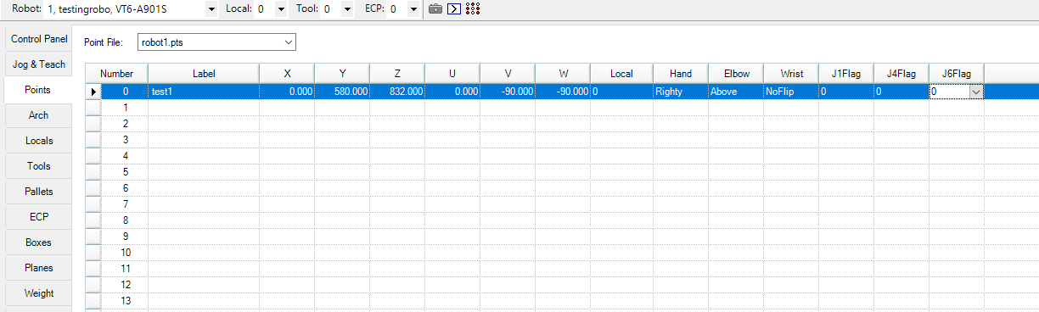
Point details

Slide 14
Point attributes
Each point definition can optionally specify a local number and various arm orientations, depending on the robot type. You can specify point attributes in point assignment statements or use individual statements and functions to change the attributes of a previously defined point.
Local point attribute: specify a local coordinate system number for a point in an assignment statement.
Hand point attribute: specify orientation for the SCARA or 6-axis robot L (for Lefty hand orientation) or R (for Righty hand orientation).
Elbow point attribute: specify elbow orientation for the 6-axis robot by A (Above elbow orientation) or B (Below elbow orientation).
Wrist point attribute: specify wrist orientation for the 6-axis robot by NF (NoFlip wrist orientation) or F (Flip wrist orientation).

Slide 15
J4Flag and J6Flag point attributes : At some points in the work envelope, the 6-axis robot can have the same position and orientation even if the fourth joint or the sixth joint is rotated 360 degrees. To distinguish these points, the J4Flag and J6Flag point attributes are provided. These flags allow you to specify a position range for joint 4 and joint 6 for a given point.

Slide 16
Go Statement-Programming
Go Statement
Moves the arm using point to point motion from the current position to the specified point. The Go instruction can move any combination of 1-6 joints at the same time.
The path is not predictable because the each joint interpolates between the current point and the target point. Be careful of the interference with peripherals. The Speed instruction determines the arm speed for motion initiated by the Go instruction. The Accel instruction defines the acceleration.

Slide 17
Go instruction can be defined in a variety of ways: -
Using a specific point to move to. For example: Go P1. - Using an explicit coordinate position to move to. For example: Go XY(50, 400, 0, 0).
Using a point with a coordinate offset. For example: Go P1 +X(50).
Using a point but with a different coordinate value. For example: Go P1 :X(50).

Slide 18
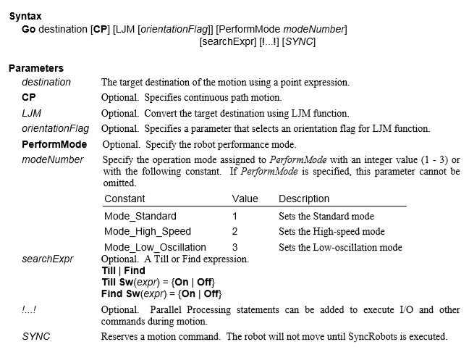
Go statement

Slide 19
Exercise 2 -Point to Point Motion
Create a Program on Robot using Go instruction (point to point )motion type.
P2
P3
P1
P4

Slide 20
Linear Motion Programming
Move Statement
Moves the arm from the current position to the specified point using linear interpolation (i.e. moving in a straight line) at a constant tool center point velocity).
Move moves the arm from the current position to destination in a straight line. Move coordinates all axes to start and stop at the same time. The coordinates of destination must be taught previously before executing the Move instruction.
Acceleration and deceleration for the Move is controlled by the AccelS instruction.
Speed for the move is controlled by the SpeedS instruction.

Slide 21
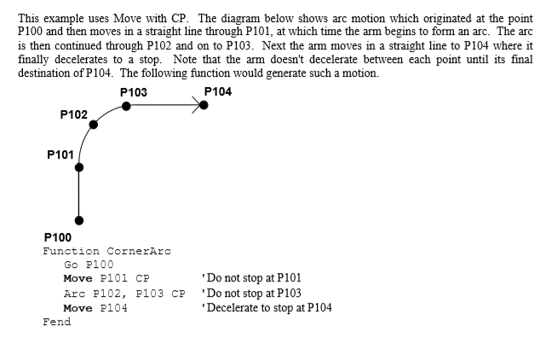
Program Example

Slide 22
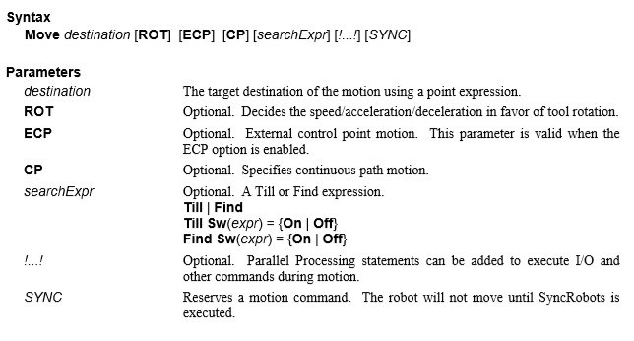

Slide 23
Exercise 3 –Linear Motion
Create a Program on Robot using Move instruction (Linear)motion type.
P2
P3
P1
P4

Slide 24
Exercise 4 –Circular Programming
Create a Program on Robot using Arc instruction (Circular)motion type.
P3
P2
P4
P1

Slide 25
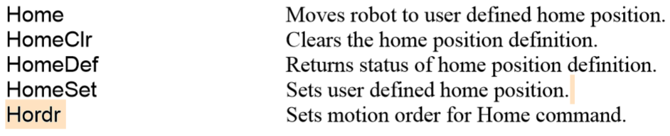
Home instructions
The Home command moves the robot to a user defined "park" or "idle" position. This command works for all robots. It is mainly used for absolute encoder robots that normally do not need to be mechanically homed. Use the HomeSet command to set the home position and the Hordr command to set the home order.

Slide 26
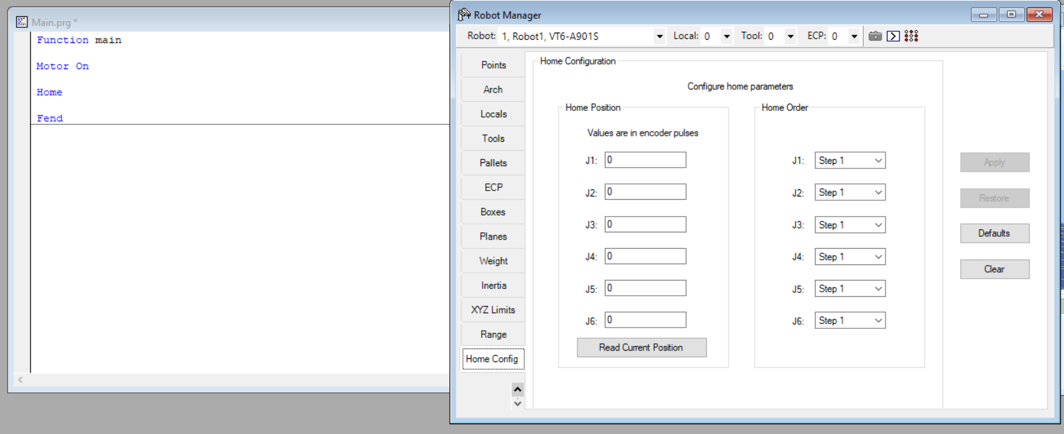
Program and Setting of Home Position

Slide 27
CP Statement
CP (Continuous Path) motion mode can be used for the Arc, Arc3, Go, Jump, Jump3, Jump3CP, JumpTLZ, and Move robot motion instructions.
When CP mode is On, each motion command executes the next statement as deceleration starts. Continuous path motion will continue regardless of whether the CP parameter is specified in each motion command or not. When CP is Off, this function is active only when the CP parameter is specified in each motion command.

Slide 28
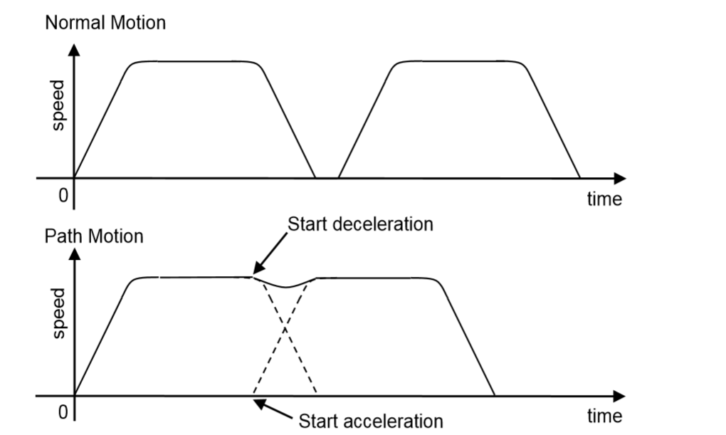
When CP is On, path motion will continue without full deceleration between two CP motions (Arc, Arc3, Jump3, Jump3CP, JumpTLZ, and Move), or two PTP motions (Go, Jump)
CP Statement Example
CP On
Move P1
Move P2
CP Off

Slide 29
Jump Statement
Moves the arm from the current position to the specified destination point using point to point motion by first moving in a vertical direction up, then horizontally and then finally vertically downward to arrive on the final destination point.

Slide 30
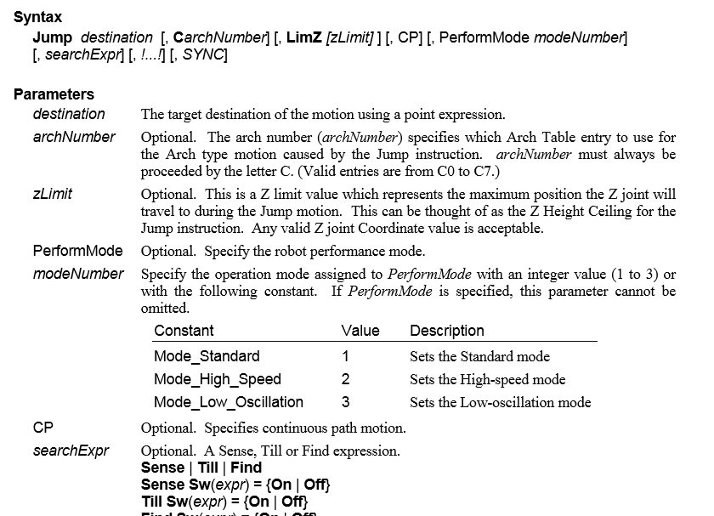

Slide 31
Jump3, Jump3CP Statement
3D gate motion. Jump3 is a combination of two CP motions and one PTP motion. Jump3CP is a combination of three CP motions.
Moves the arm from the current position to the destination point with 3D gate motion. 3D gate motion consists of depart motion, span motion, and approach motion. The depart motion form the current position to the depart point is always CP motion. The span motion from the depart point to the start approach point is PTP motion in Jump3, and the CP motion in Jump3CP. The approach motion from the starting approach point to the target point is always CP motion.

Slide 32
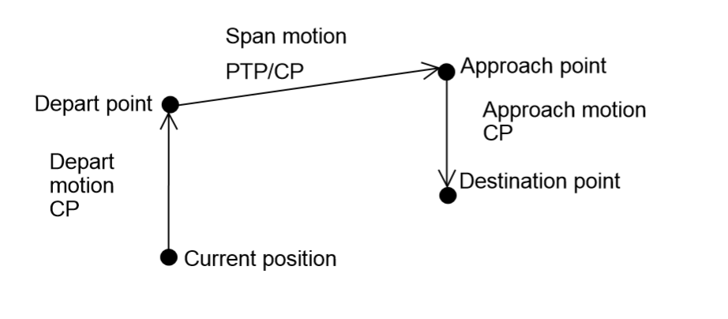
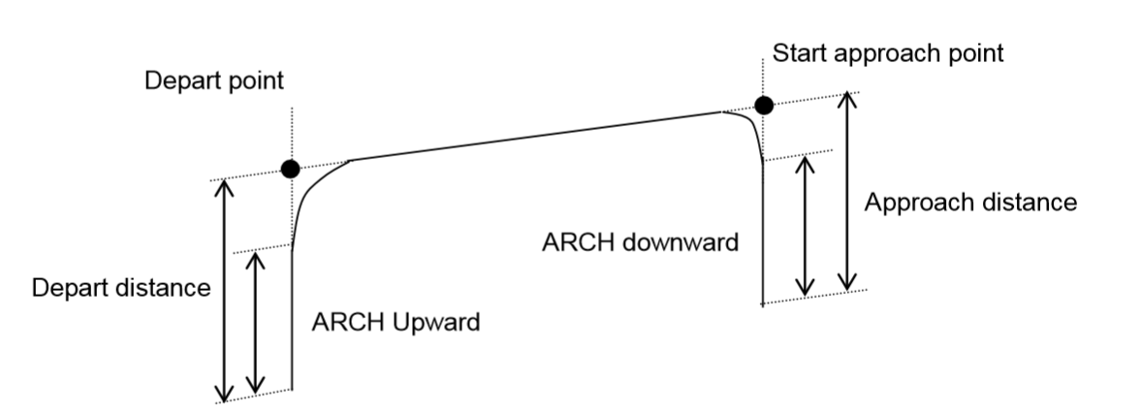

Slide 33
Arch motion is achieved by specifying the arch number. The arch motion for Jump3, Jump3CP is as shown in the figure below. For arch motion to occur, the Depart distance must be greater than the arch upward distance and the Approach distance must be greater than the arch downward distance.

Slide 34
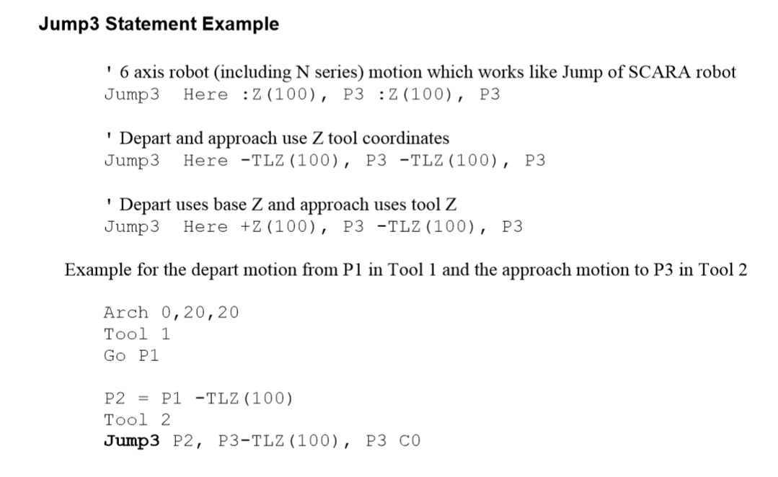
Jump3 Example

Slide 35
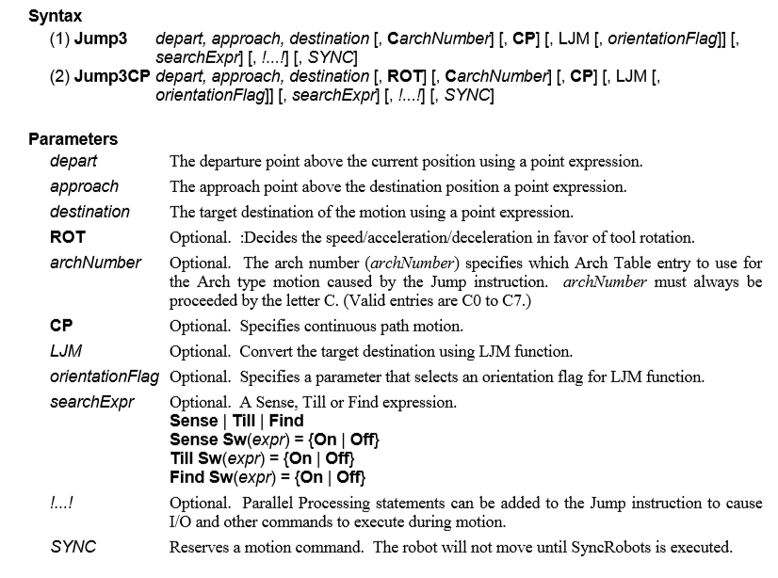

Slide 36
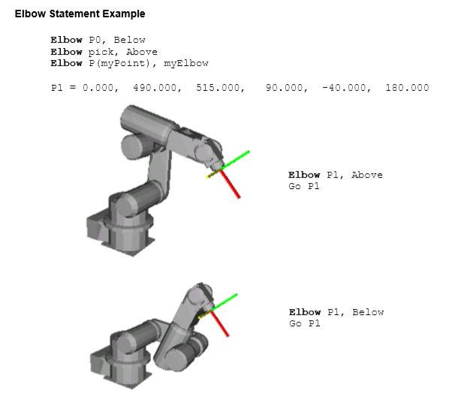
Elbow Statement
Sets the elbow orientation of a point
Syntax (1) Elbow point [, value] (2) Elbow

Slide 37
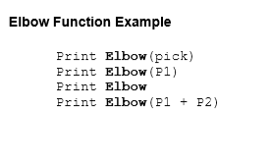
Elbow Function
Returns the elbow orientation of a point.
Syntax :Elbow (point)]

Slide 38
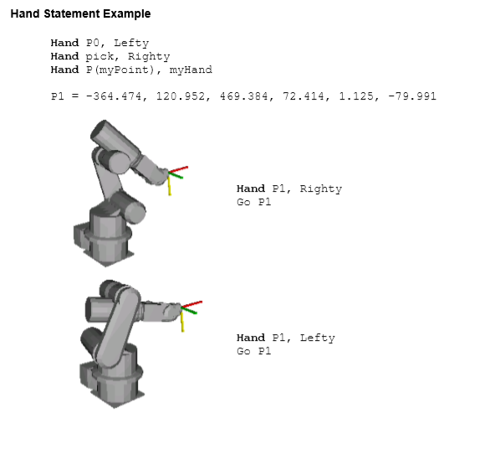
Hand Statement
Sets the hand orientation of a point.
Syntax (1) Hand point [, Lefty | Righty] (2) Hand

Slide 39
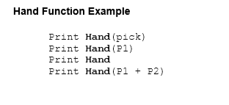
Hand Function
Returns the hand orientation of a point.
Syntax :Hand (point)
Return Values: 1 Righty (/R) ;2 Lefty (/L)

